Slide 1
TPOT: A Tree-based Pipeline Optimization Tool for Automating Machine Learning -- R S. Olson and J H. Moore
Presenter: Matt and Eric

Slide 2
Motivation
Machine Learning is commonly hoped to be “machine” and “learning” without manually manipulation.
However, it’s still tedious programming now.
Can we develop any automated method to save human labors?

Slide 3
ML pipeline in our first paper
Data preparation
Feature engineering
Model selection
Hyperparameter optimization
Model evaluation

Slide 4
TPOT feature
Data preparation
Feature engineering
Model selection
Hyperparameter optimization
Model evaluation

Slide 5
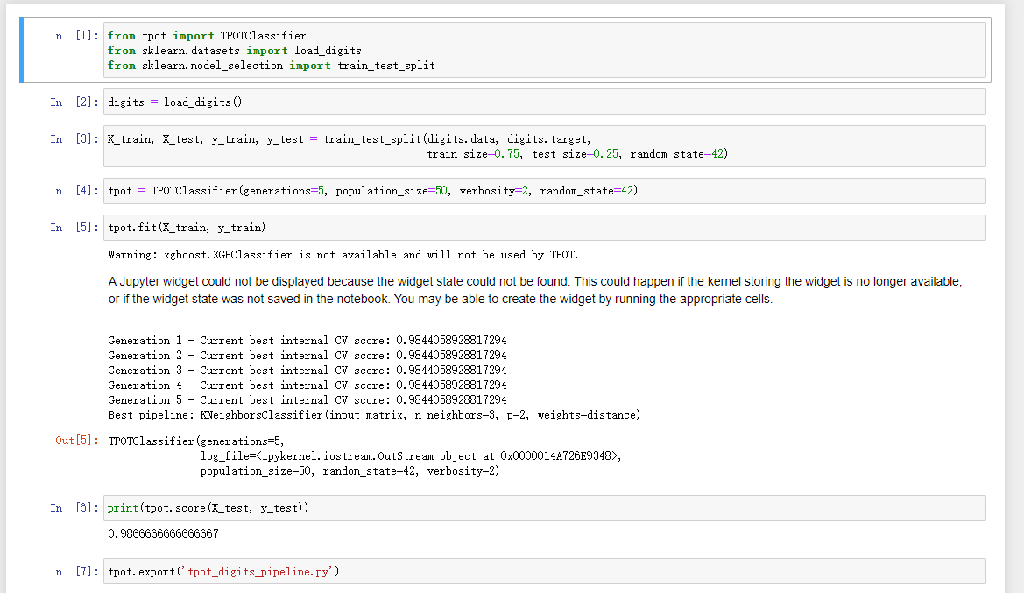
Demo of TPOT for classification

Slide 6
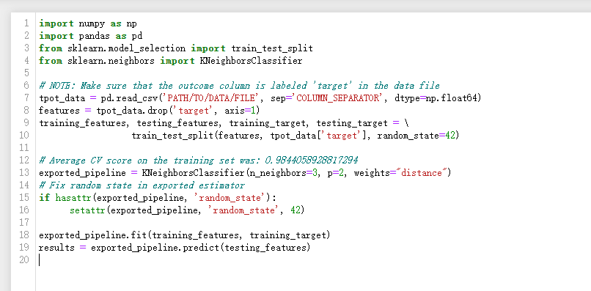
Demo of TPOT for classification

Slide 7
What is the internal mechanism of TOPT?
“TPOT stands for Tree-based Pipeline Optimization Tool. Consider TPOT your Data Science Assistant. TPOT is a Python Automated Machine Learning tool that optimizes machine learning pipelines using genetic programming.”

Slide 8
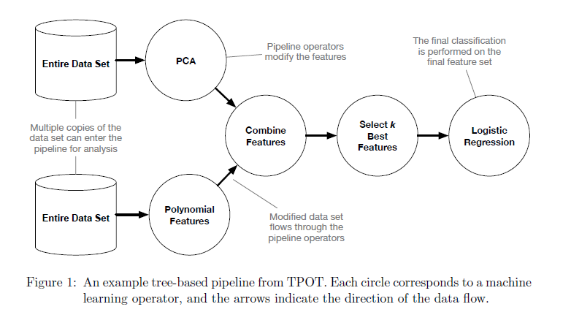
Tree-based
Feature Selection Operators:
VarianceThreshold
SelectKBest
SelectPercentile
SelectFwe
Recursive Feature
Feature Preprocessing Operators:
StandardScaler
RobustScaler
MinMaxScaler
MaxAbsScaler
RandomizedPCA
Binarizer
PolynomialFeatures
Supervised Classification Operators:
DecisionTree
RandomForest
eXtreme Gradient Boosting Classifier
Logistic Regression
KNearestNeighborClassifier

Slide 9
Genetic programming
Ramdomly generate 100 tree-based pipelines and evaluate accuracy.
Select the top 20 pipelines, where pipelines simultaneously maximize the accuracy and minimizing the number of operators.
Each 20 pipelines produce 5 copies, totally 100 pipelines again.
5% of those 100 pipelines cross over with another using one-point crossover.
90% of the remaining un-crossovered pipelines

Slide 10
Genetic programming

Slide 11
Genetic programming
Top 20 performance

Slide 12
Genetic programming
Top 20 performance

Slide 13
Genetic programming

Slide 14
Genetic programming
5% one-point crossover
90% of remaining unaffected offspring are randomly changed by a point, inset, or shrink mutation.

Slide 15
Interesting genetic programming
https://www.youtube.com/watch?v=GOFws_hhZs8&t=2s

Slide 16
Experiment results
Data set is split into 75%/25%.
TPOT: 30 replicates of TPOT for 100 generations on 150 ML missions.
Baseline: 30 replicates of Random Forest with 500 trees on 150 ML missions.
Results:
21/150 statistically significantly better.
4/150 significantly worse.
125/150 no difference.

